Slide 1
Thermal, hydraulic and electromagnetic modeling of superconducting magnet systems
Luca.Bottura @cern.ch
International Conference on Magnet Technology
July 14 – 19, 2013
The Westin Copley Place
Boston, MA USA

Slide 2
The (coupled) physics domains
Physics | Phenomena | Time scale
Heat flow | Heat flow from supports and structures Heat flow in the coil winding Heat flow along the wire/tape/cable | 1 s 1 s 100 μs
Fluid-dynamics | Proximity cryogenics and refrigeration Coolant steady and transient flow in magnets Coolant steady and transient flow in cables | 100 s 1 s 1 ms
Electro-magnetics | Steady and transient coil currents Steady and transient magnetic fields Current distribution in the wires/tapes/cable Steady and transient Magnetization | 1 s 1 s 1 ms 10μs
Mechanics | Structure mechanics and coil support Coil mechanics under thermal and e.m. loads Cable mechanics Microscopic mechanics | 1 s 1 s 1 ms 100 μs

Slide 3
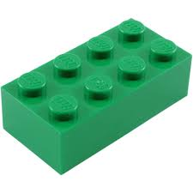
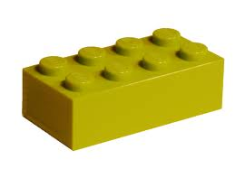
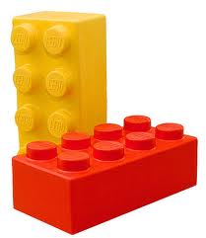
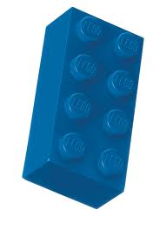
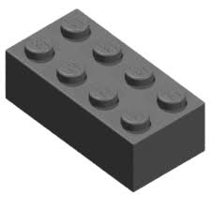
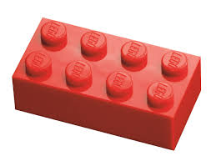
How to attack the problem ?
Different physics domains are strongly coupled on comparable time scales
We can imagine a set of building bricks (LEGO), each dedicated to a given “domain”
Geometric proximity (space domains) and difference of characteristic times (time scale domain) are suitable principles to decompose the domains in simpler bricks
Note: a splitting in physics domain does not necessary yield an easier solution

Slide 4
The (coupled) physics domains
Physics | Phenomena | Time scale
Heat flow | Heat flow from supports and structures Heat flow in the coil winding Heat flow along the wire/tape/cable | 1 s 1 s 100 μs
Fluid-dynamics | Proximity cryogenics and refrigeration Coolant steady and transient flow in magnets Coolant steady and transient flow in cables | 100 s 1 s 1 ms
Electro-magnetics | Steady and transient coil currents Steady and transient magnetic fields Current distribution in the wires/tapes/cable Steady and transient Magnetization | 1 s 1 s 1 ms 10μs
Mechanics | Structure mechanics and coil support Coil mechanics under thermal and e.m. loads Cable mechanics Microscopic mechanics | 1 s 1 s 1 ms 100 μs
Cable
Cryogenics
Conduction
Circuits
Magnetics

Slide 5
Cable LEGO

Slide 6
Cable models – CICC’s
Initial work (1970…1990) was mostly devoted to the helium state and flow, when it was recognized that much of the cable performance depended on cooling
Only later (1990…2000) significant work moved to including self-consistent current distribution and redistribution
The most advanced cable models can solve for
Conductor temperature (trivial: parabolic, self-adjoint problem, optimal numerical techniques exist)
Coolant state and flow (tough: hyperbolic system of PDE, no optimal numerical scheme exist)
Current distribution (tricky: basic equations can be written in different manners, requiring different schemes)

Slide 7
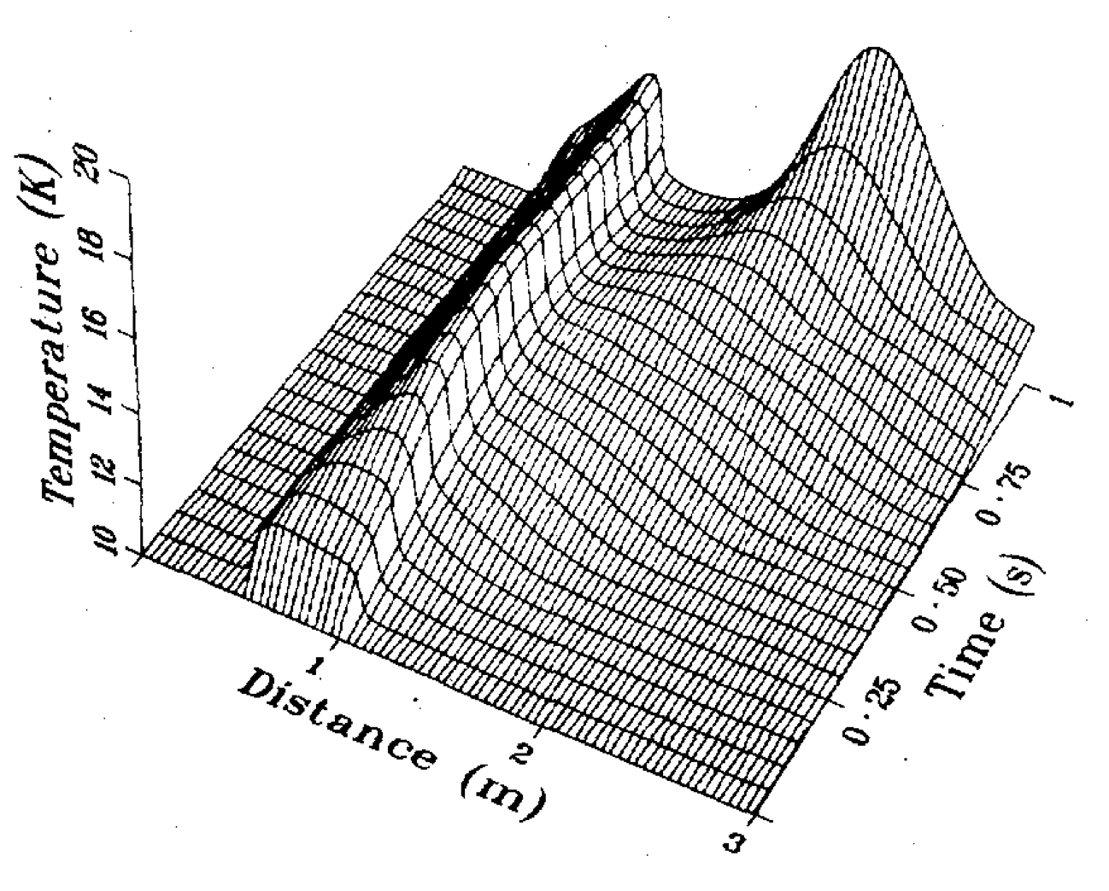
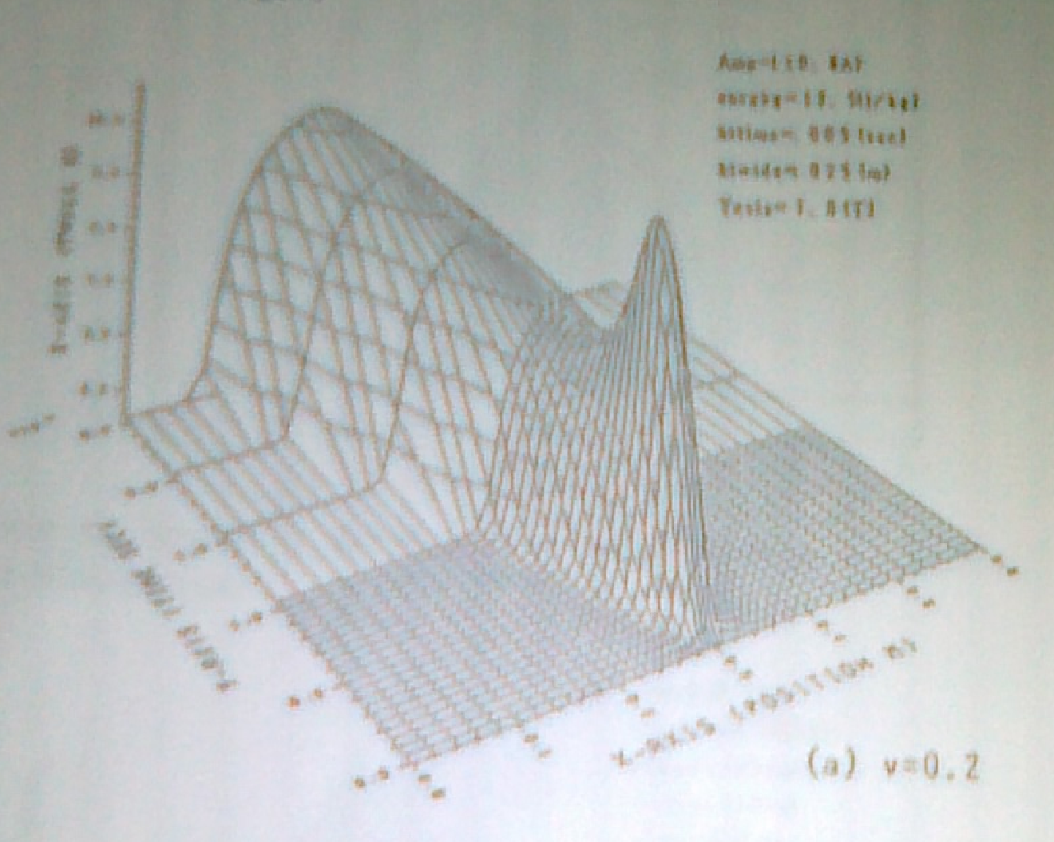
A bit of pre-history: 1970-1980
First models (known to me): Lee [Lee-1978], Hoffer [Hof-1979], simplified form of the flow equations (no inertia)
Junghans [Jun-1983] (LONSA) further exploits simplified model
Benkowitsch [Ben-1979] validates compressible flow model for supercritical helium (YAQHEL)
Arp [Arp-1980] manipulates flow equations, and produces a code adequate for stability and quench analysis, later used extensively at MIT, NET, and appearing in various instances (clones and mutations) at later times
Downstream propagation only ?!?
[Hof-1979]
[Aga-1987]
Two-sided propagation

Slide 8
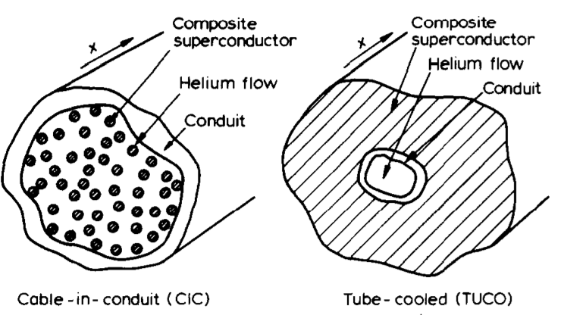
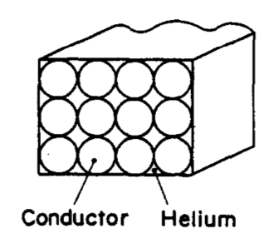
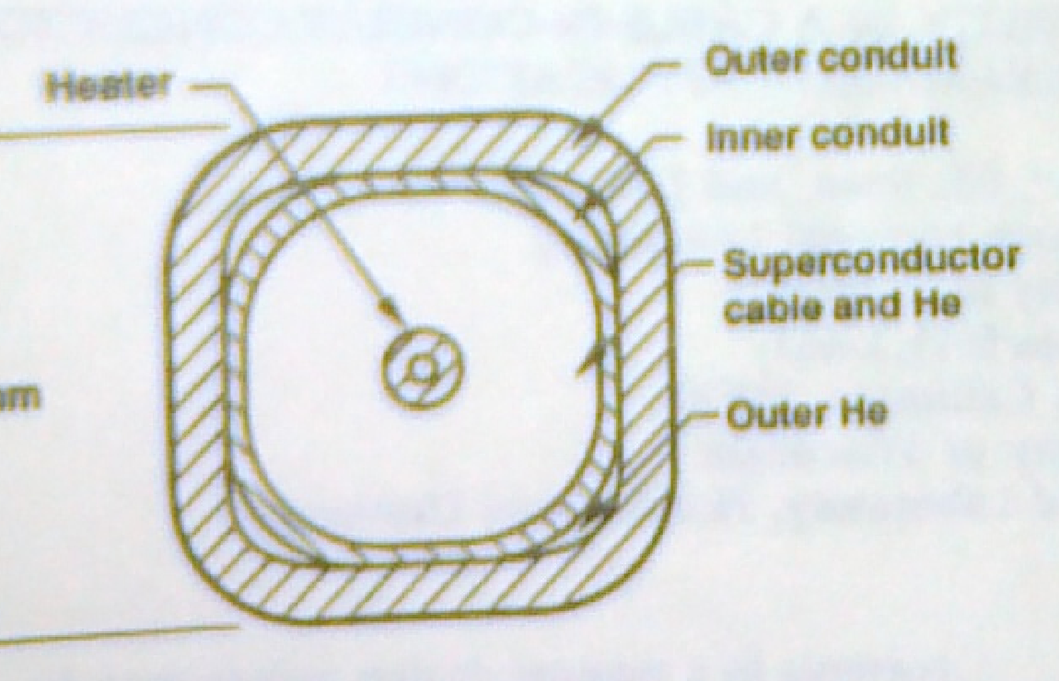
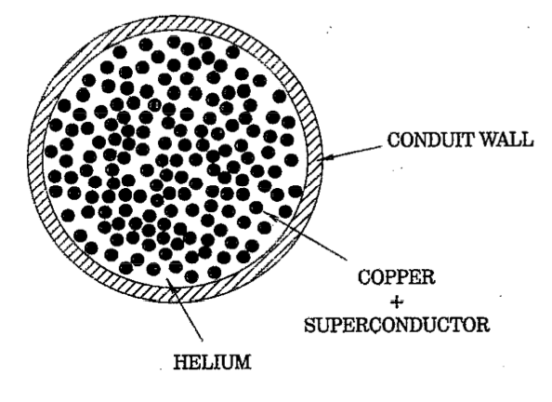
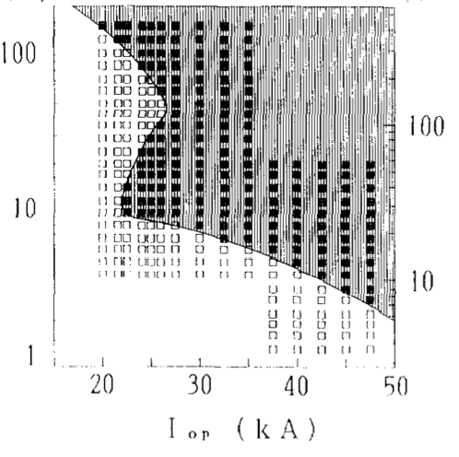
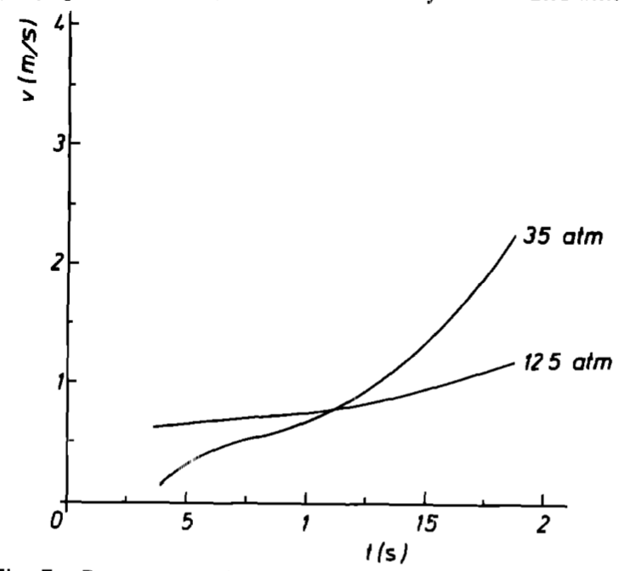
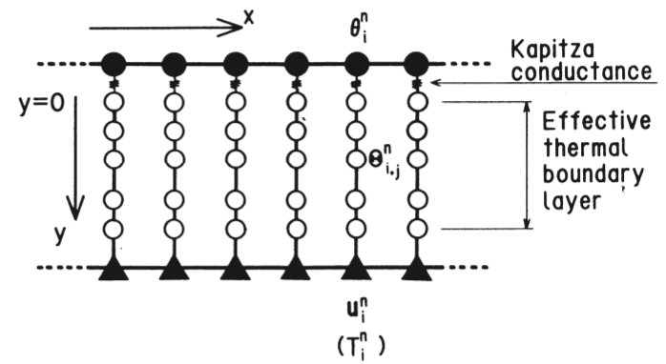
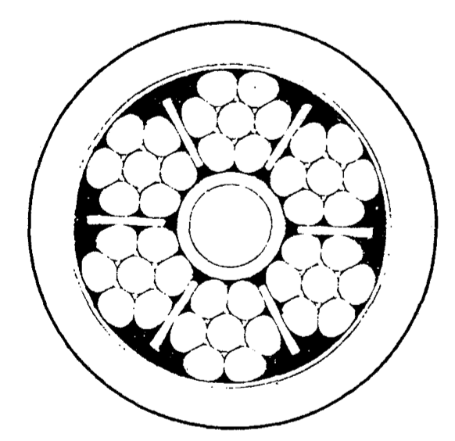
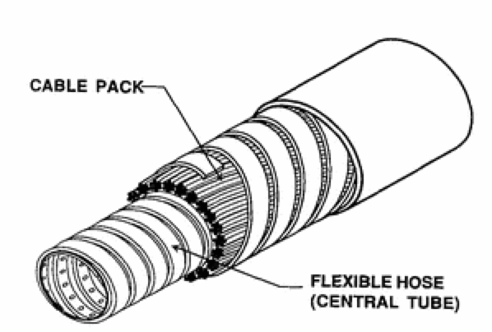
Flourishing of models: 1980-2000
1983: Marinucci [Mar-1983], in collaboration with Hilal [Mar-1979], develops models for stability (FOCS) and quench (QUBIG)
1987: Agatsuma, using a clone of Arp’s code [Aga-1987]
1991: Wong, stability analysis of US-DPC CICC [Won-1991]
1989: Sekiya develops fast quench model [Sek-1989]
1994: Shajii’s quench theory and QUENCHER [Sha-1994]
1980
understand
code
1990
add features
2000
1983: LONSA [Jun-1983]
[Tad-1989]
1991: Dual stability simulations [Kam-1991]
[Arp-1980]
1985: Quench propagation simulations by Cornelissen [Cor-1985], identify THQB
1996: Koizumi develops quasi-2-D model (POCHI/POCHI2)[Koi-1996]
1979: YAQHEL [Ben-1979]
1994: Martinez studies CICC with central channel [Mar-1994]
1992: Saruman [Bot-1992]
1995: Mythrandir [Zan-1995]
1996: Gandalf [Bot-1996]
1989: Luongo simulates THQB HEDUMP [Luo-1989]
1994…2000: Vincenta [Sha-xxxx]
2000: THEA [Bot-2000]

Slide 9
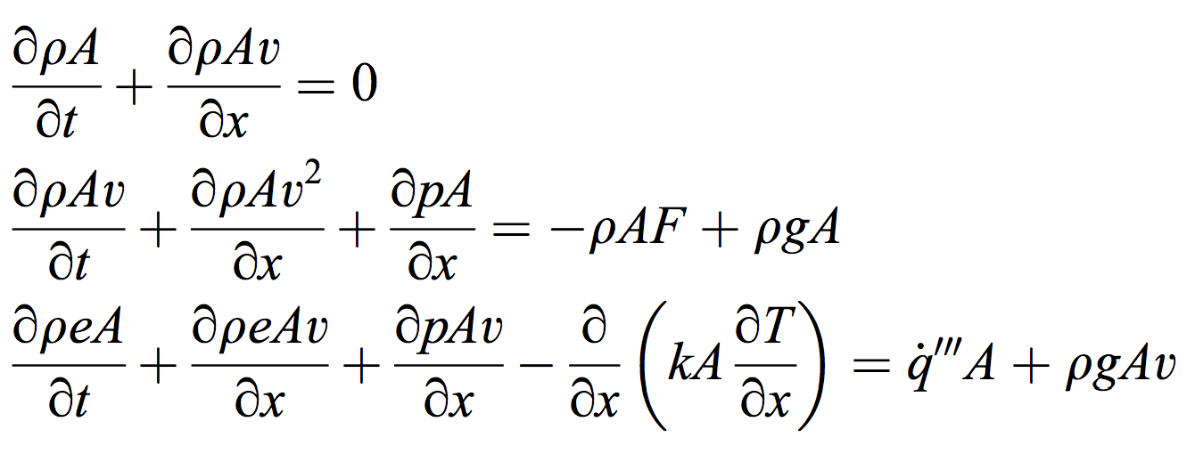
To conserve or not to conserve ?
The use of conservative form equations is (nearly) a religious dogma in CFD (mandatory
for high-speed flow, shock propagation,…)
Down-side: conservative variables are not convenient for coupled multi-physics problems
Low-Mach flows are driven by pressure, and they exhibit no shocks
The exchange of heat between “coolant” and “cooled” is governed by temperature difference
Thou shalt preserve all physically conserved quantities through your numerical scheme
No need to conserve !

Slide 10
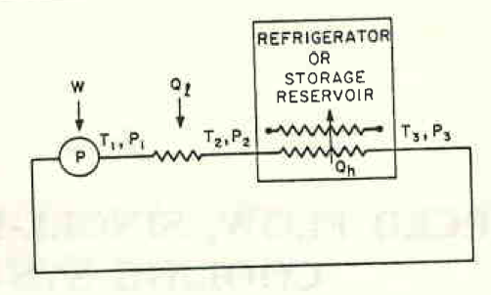
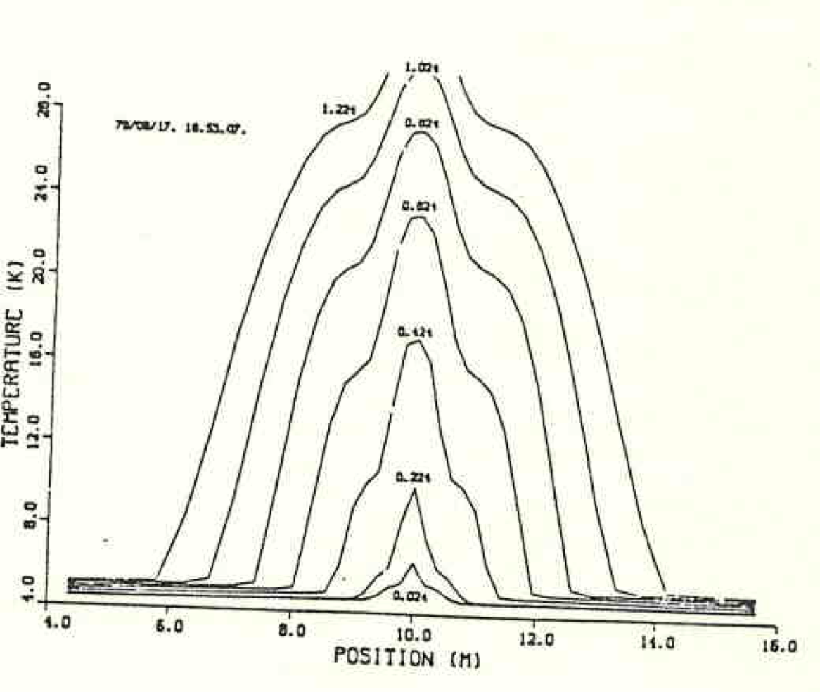
Seminal work of V. Arp
A complete and exact set of equations for a 1-D flow of a compressible fluid (helium) in non-conservative form
V.D. Arp, Stability and Thermal Quenches in Force-Cooled Superconducting Cables, 1980 Superconducting MHD Magnet Design Conference, MIT, pp. 142-157, 1980
V.D. Arp, Forced Flow, Single-Phase Helium Cooling Systems, Adv. Cryo. Eng.ng, 17, pp. 342-351, 1972
Quench initiation and propagation in a force-flow cooled conductor
V.D. Arp, Thermodynamics of Single-Phase One Dimensional Fluid Flow, Cryogenics, 15, 285, 1975

Slide 11
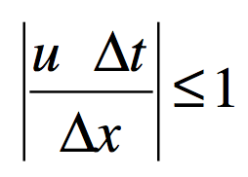
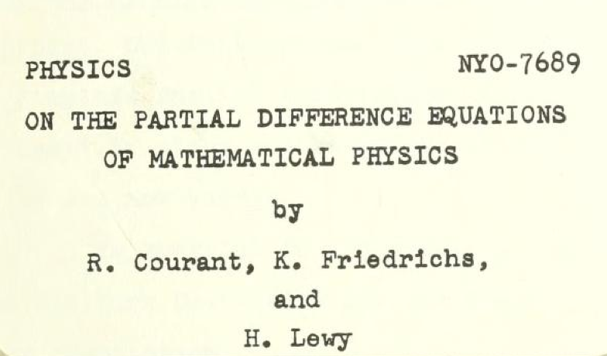
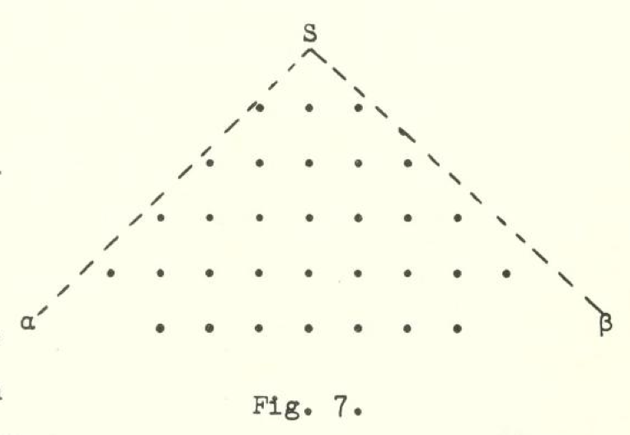
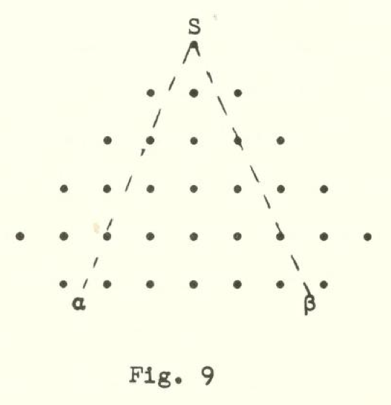
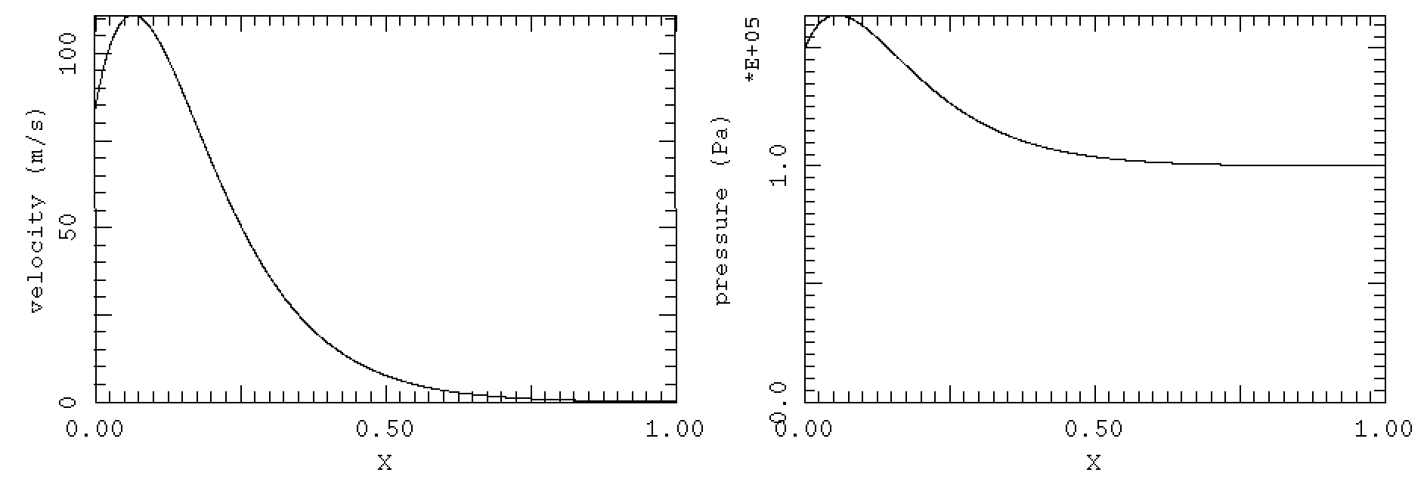
CFL condition
CFL condition for stability (Courant, Friedrichs, Lewy, 1928)
Can be grossly violated by using p as primary variable, still maintaining a physical solution (albeit inaccurate at the CFL time scale)
CFL >1
CFL<1
CFL_{trans}
CFL = 0.1
CFL_{long}
Δt_{CFLtrans} ≈ 10μs
CFL = 1000
(p,v,T) form makes ITER quench simulation possible
(p,v,T) simulation of pressure wave

Slide 12
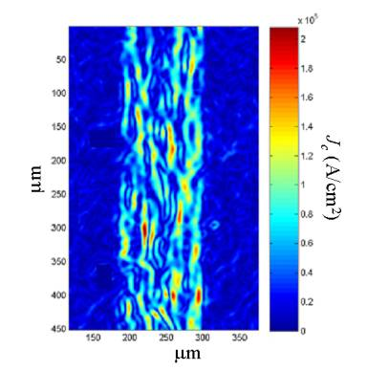
Current distribution models
Current distribution in cables can be treated in different ways:
Network models, well adapted to cables where contacts are localised (e.g. cross contacts)
Differential equation models, suited for cables where contacts are distributed over the legth (e.g. line contacts)
Continuum electromagnetics, a non-isotropic solid description of a cable that can be reduced to a system of PDE in 2D or 3D (NOTE: connection to differential forms on manifolds, very active field of research)
None of the above is necessarily the “best”

Slide 13
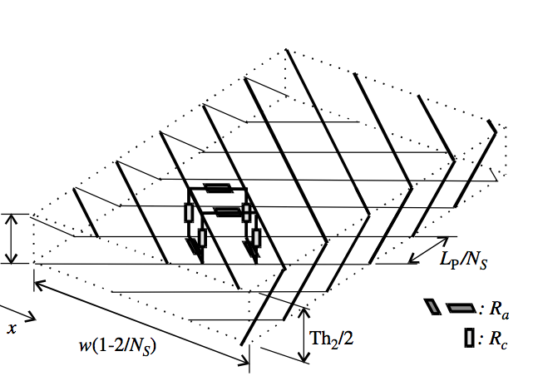
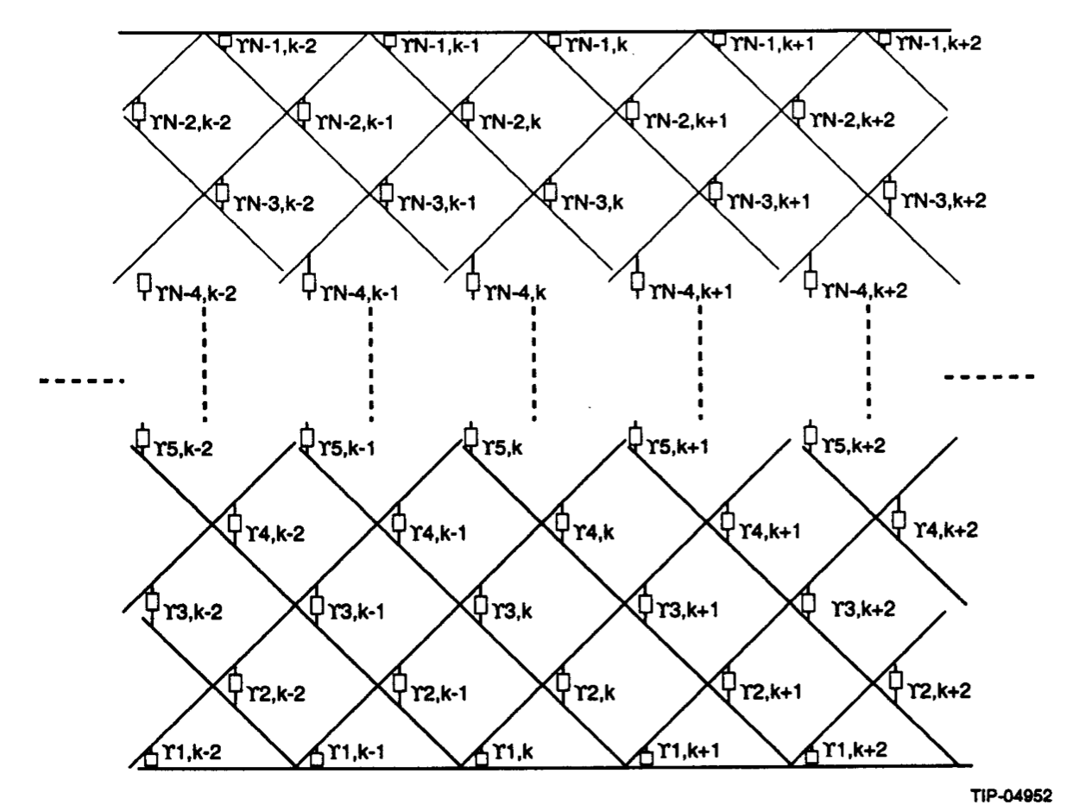
Network models
A cable is represented by “sticks” forming a lumped-parameter network of inductances and (non-linear) resistances
Twente University [Nie-1993]
SSC work [Akh-1994]
CUDI [Ver-2006]
Jackpot [Laa-2010]
Final equation:
L dI/dt +R I = V
Limited to short cable lengths

Slide 14
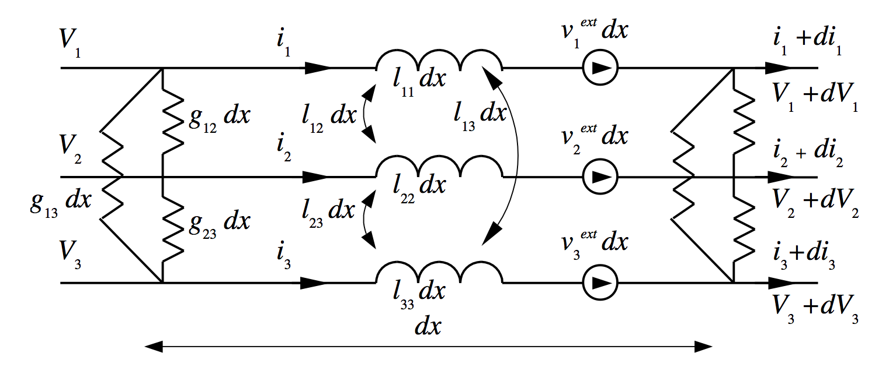
Continuum models
The current distribution is described ty differential equations as used in the analysis of transmission lines
Turck (1974), Schermer (1980), Ries (1980), …
Krempaski and Schmidt [Kre-1995]
Bottura, Breschi, Fabbri [Bot-2002]
THEA [Bot-2000]
THELMA [Zan-2005]
Final equation:
g l di/dt +r d²i /dx² + g r i = g v
Requires continuum (non-singular) contact functions

Slide 15
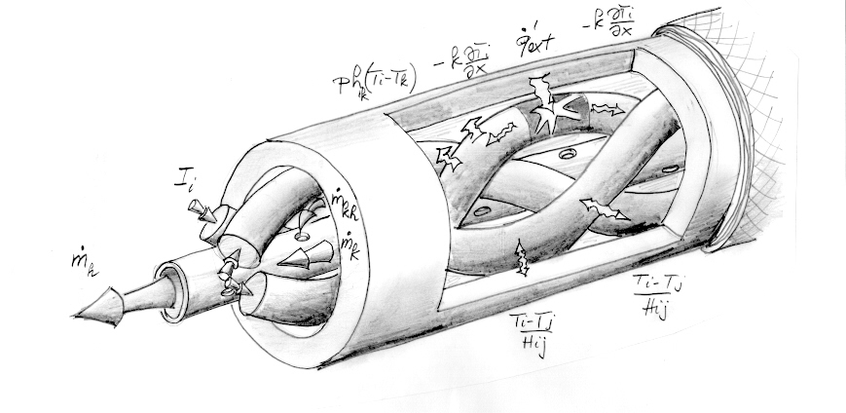
State-of-the-art in cable models
Arbitrary number of cable solid components that can carry current and transport heat
Arbitrary number of cooling channels
Unlimited range of modeling (no approximations) and operating conditions (wide-range material properties)
Error control and adaptive solver (time and space)
Manageable
THEA [Bot-2000], THELMA [Zan-2005]

Slide 16
Cryogenic LEGO

Slide 17
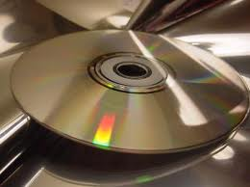
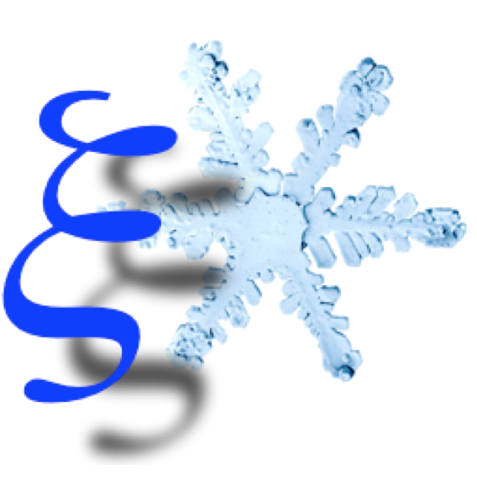
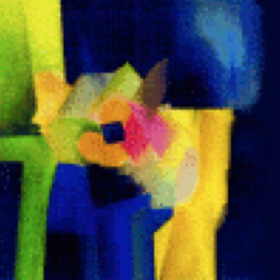
Cryogenic models
An equivalent hydraulic network consisting of nodes (volumes) and interconnecting components (pipes, valves, pumps, …) largely inspired by nuclear and oil/gas piping process simulation softwares
Two posible approaches:
Bob-the-builder
FLOWER: initiated as a boundary condition simulator, evolved in an autonomous network simulator [Bot-2003]
VINCENTA/VENECIA: a proximity cryogenic simulator is the basic engine of the analysis package [Ven-2013]
ADE S/W
Modelica/ThermoPower: Equation-based modelling package, assemble components from a library adapted for He [Sav-2010]
EcosimPro: DAE solver, specific libraries developed at CERN [Bra-2013]

Slide 18
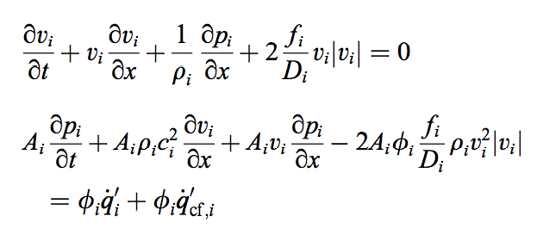
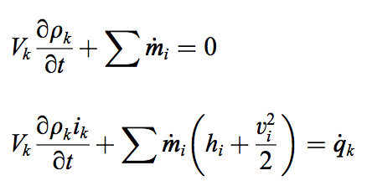
Cryogenic models – features and issues
Cryogenic fluids require adjustment w/r to standard process simulators in order to describe the relevant phenomena
Phase change and separation are crucial to refrigeration
Helium physics (e.g. He-II) is much different from that of gas, oil or water
Equations describing dynamics are of various and different nature (A, ODE, PDE):
Fast, flexible and generic solver for Algebraic and Differential Equations is mandatory to manage real-size systems

Slide 19
Heat conduction LEGO

Slide 20
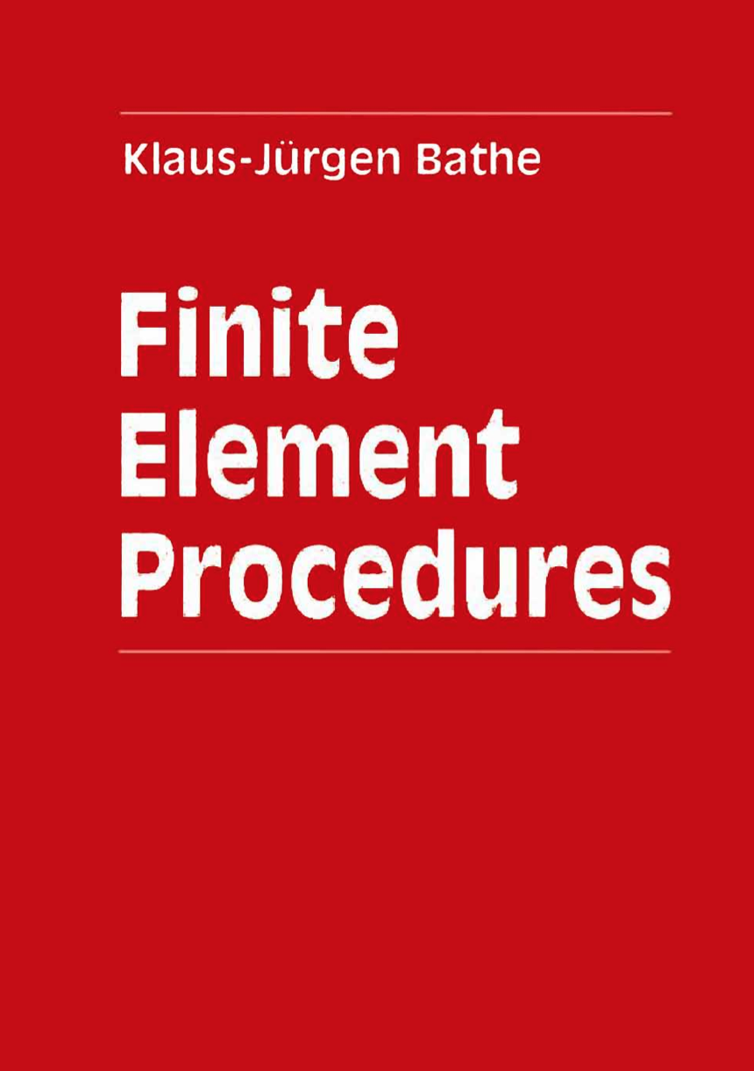
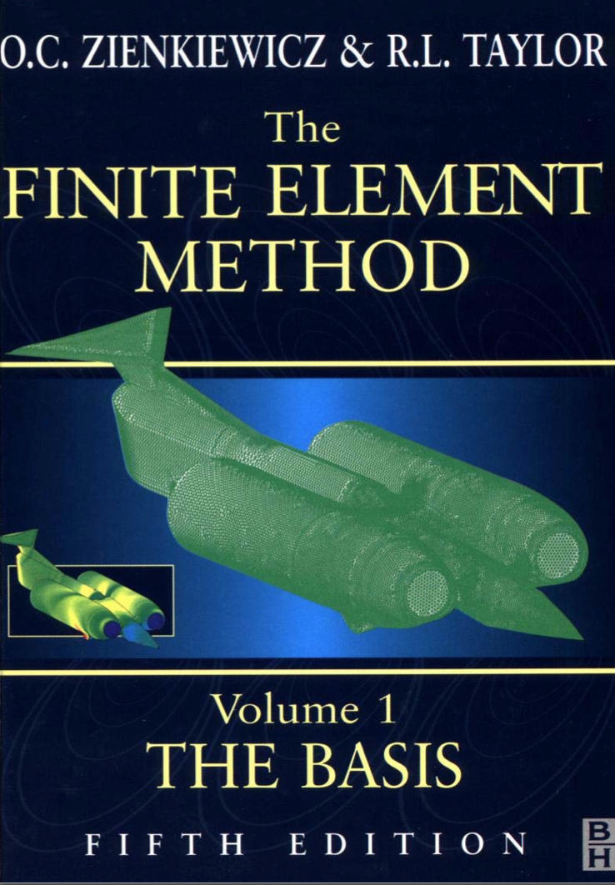
Heat conduction models
Trivial mathematical problem
parabolic system of PDE
FE is optimal for the solution
Time algorithm well established
A (large) number of commercial S/W are available for the solution of heat transfer in non-linear, non-isotropic media
A (large) number of open-source S/W are similarly available
The challenge is to find a suitable and stable interface for coupling (cross-systems ?)

Slide 21
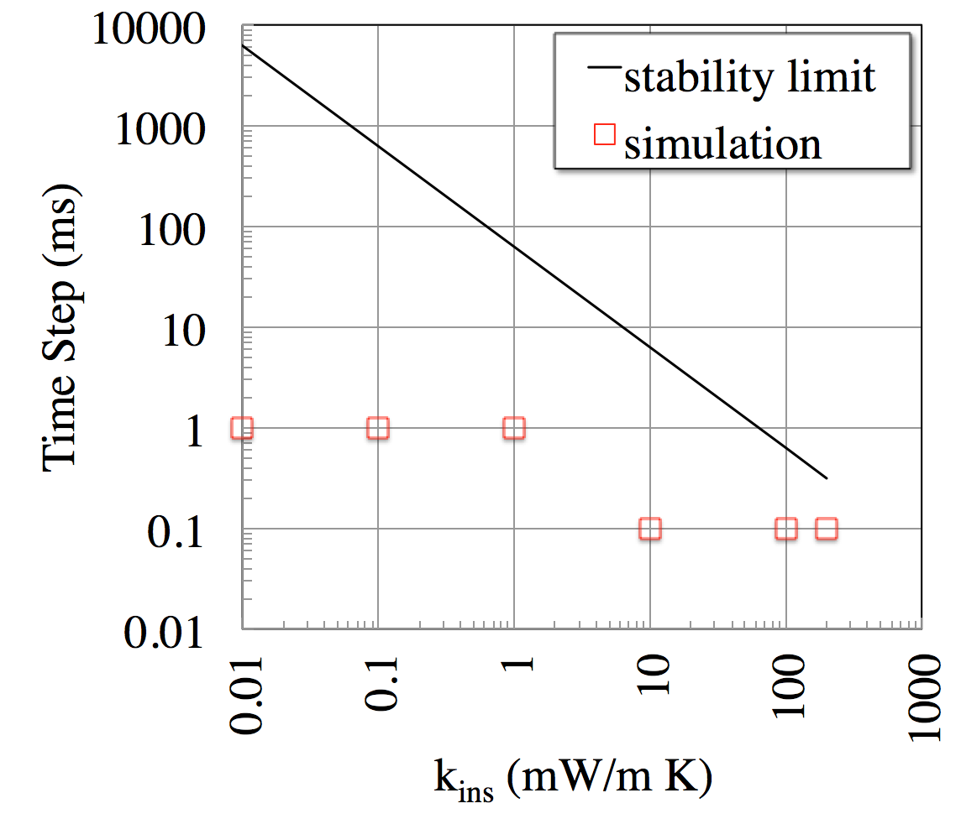
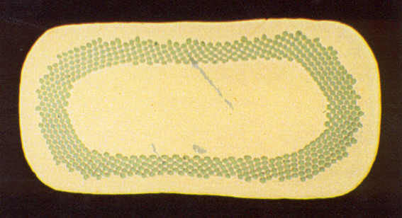
Stability of coupling
AρC
ph
AρC
Coupling heat conduction domains explicitly is subjected to stability conditions on the maximum allowable time step
Small heat capacity and large thermal conductance require small time steps for the stability of the coupling
T₁
T₂
AρC dT₁/dt = ph (T₂-T₁)
AρC dT₂/dt = ph (T₁-T₂)
Δt ≤ AρC / ph

Slide 22
Current and field LEGO

Slide 23
Circuit models and magnetic fields
A wealth of models and codes are available for the simulation of
Current transients in a circuit made by an arbitrary number of inductances, resistances (capacitances, current and voltage sources, passive and active non-linear components, …)
Magnetic field generated by arbitrary current distributions in space (steady state and transient, in presence of magnetic materials, …)
Consistent modelling is important, e.g.
current waveform in case of quench with no dump
AC-loss induced quenchback
Coupling is “easy”, as the time scales of the circuit response are naturally long (large inductances, and small resistances)

Slide 24
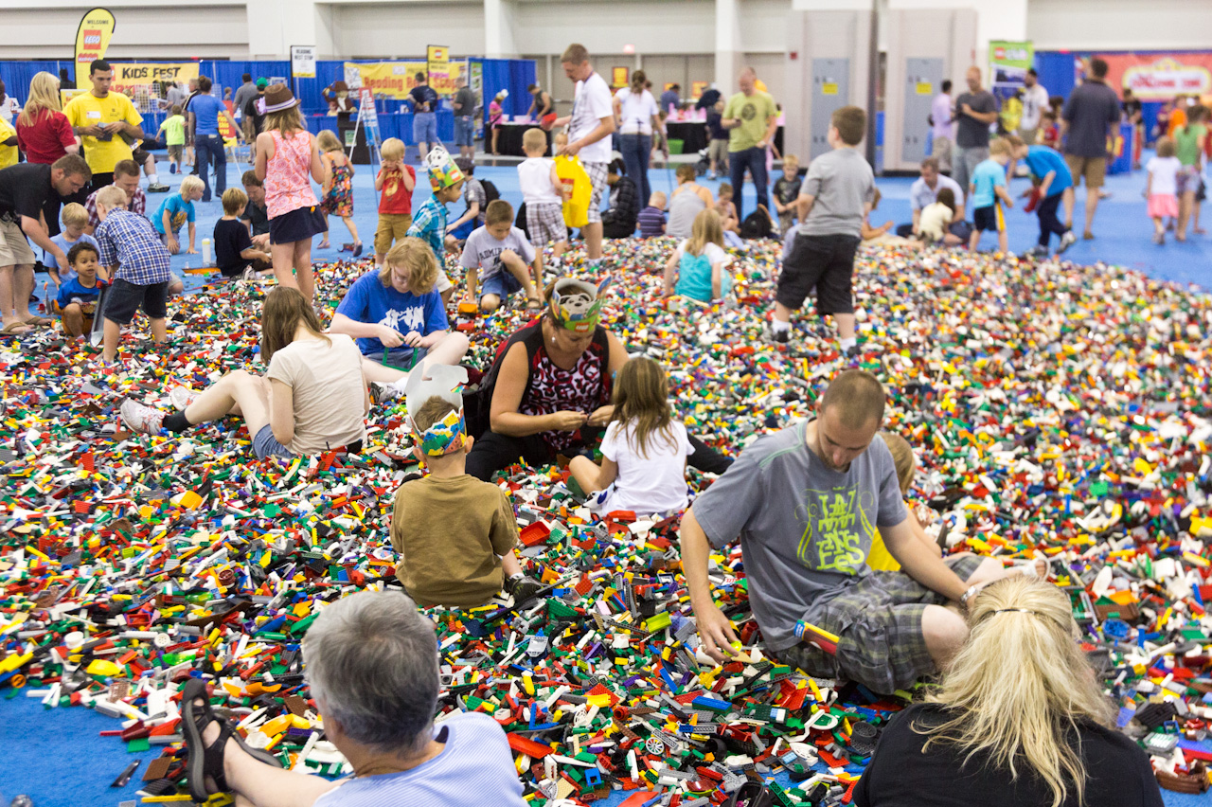
Putting it all together

Slide 25
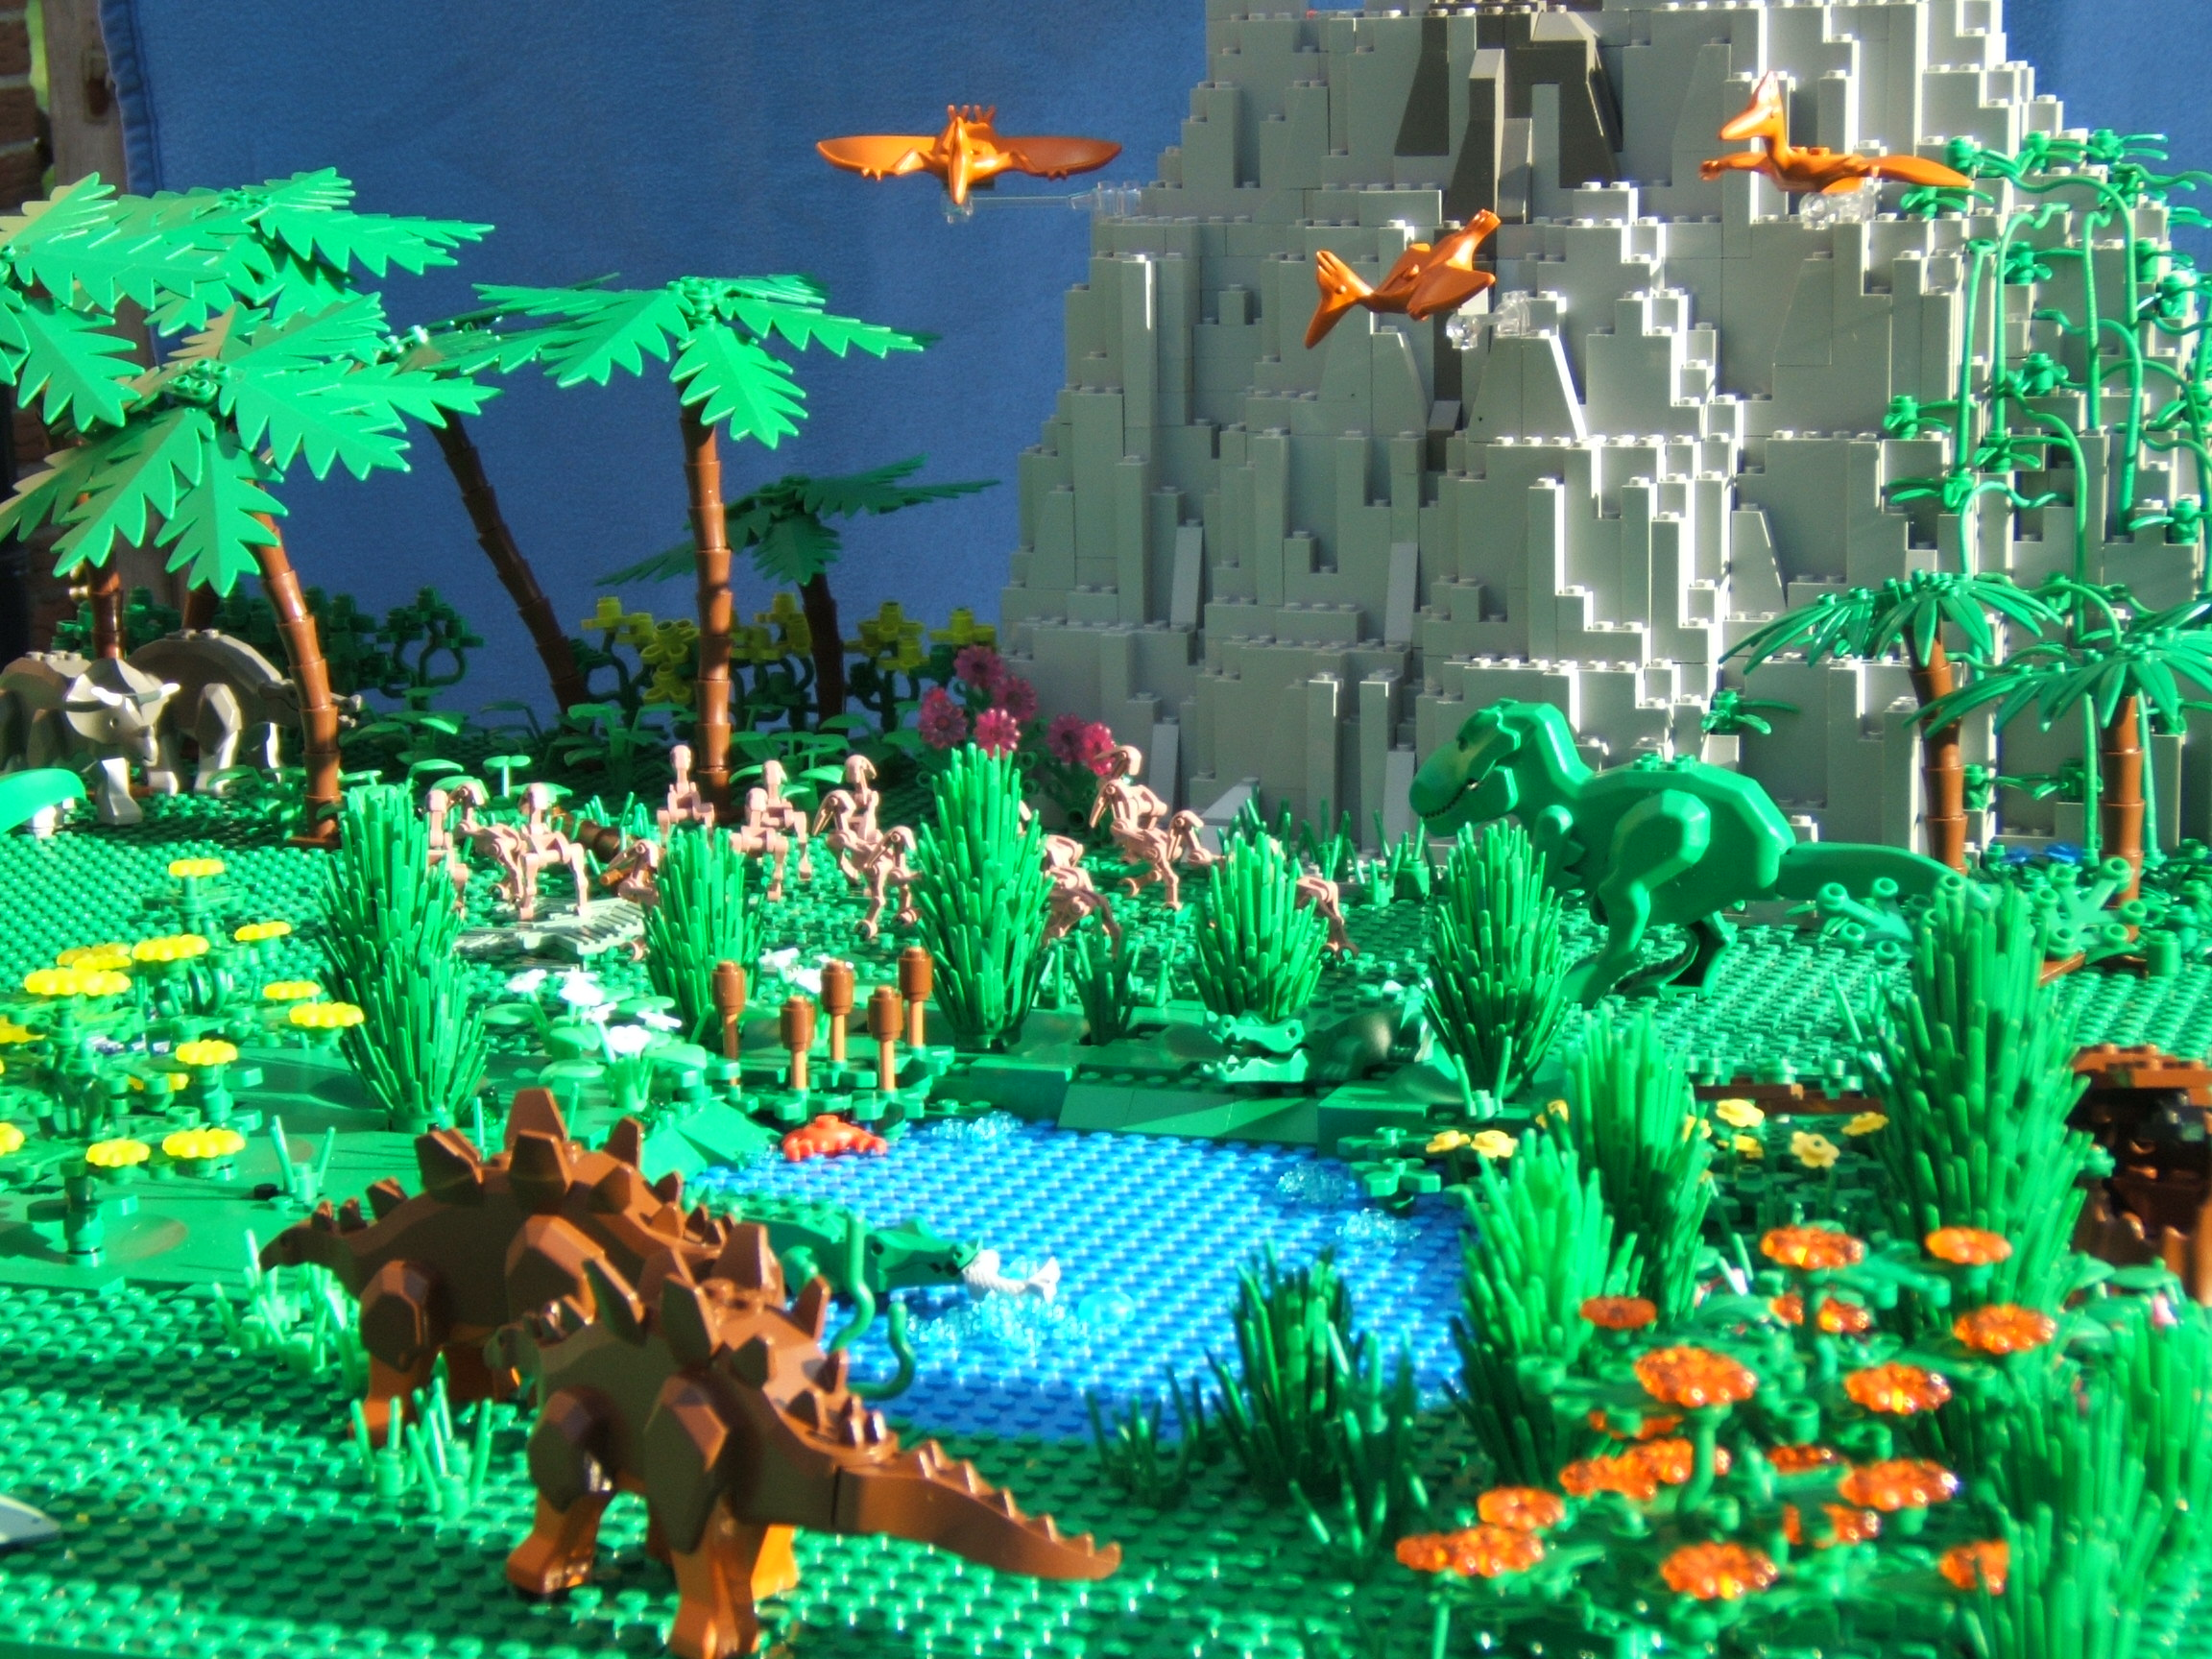
MAGS [Mey-1993], [Pas-2003]
In a world of dynosaurs

Slide 26
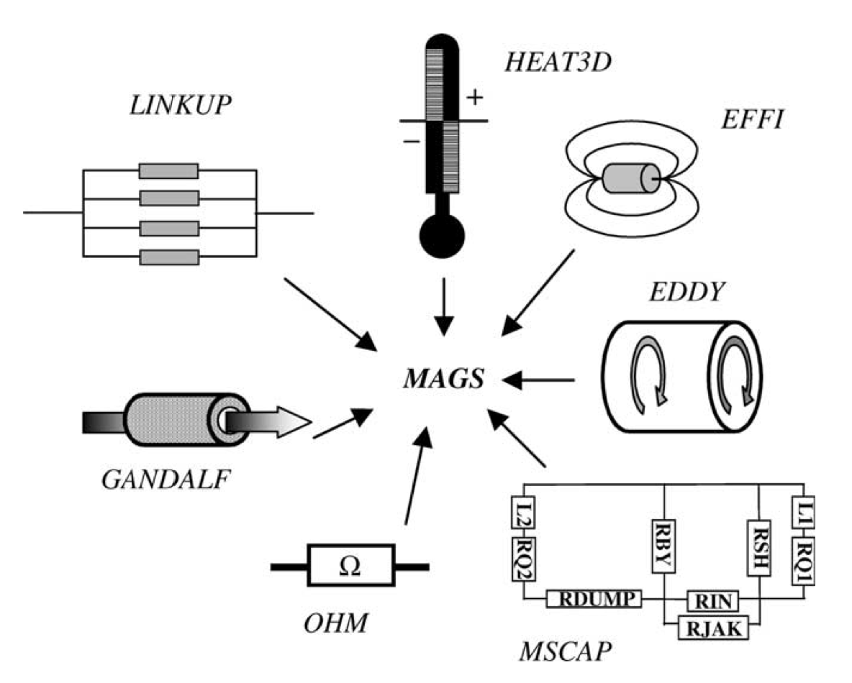
MAGS description
Several independent modules
Winding pack temperature (HEAT3D)
Inductances and field (EFFI)
Cable AC loss (EDDY)
Circuit analysis (MSCAP)
Quench resistance and power (OHM)
He dynamics (GANDALF)
He flow in the manifolds (LINKUP)
Execution sequence is created using a meta-language (similar to FORTRAN DO loops)
Modules are communicating through a shared memory area (managed by a system dependent communication language)

Slide 27
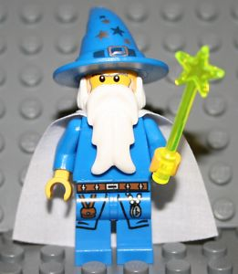
Saruman [Bot-1994]/Gandalf [Bot-1996]
A little fun

Slide 28
SARUMAN/GANDALF description
The cable simulator is the main engine, calling the hydraulic and electric network solvers as FORTRAN SUBROUTINES
Monolithic code, compiled all at once and static
SARUMAN/GANDALF
Time stepping loop
do while(t<tend)
...
System solution
...
enddo
FLOWER
Call Flower()
Call Power()
POWER

Slide 29
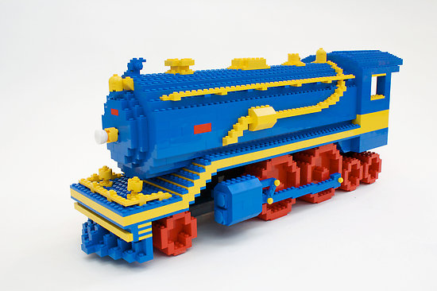
VINCENTA/VENECIA [Ven-2013]
Heavy duty stuff

Slide 30
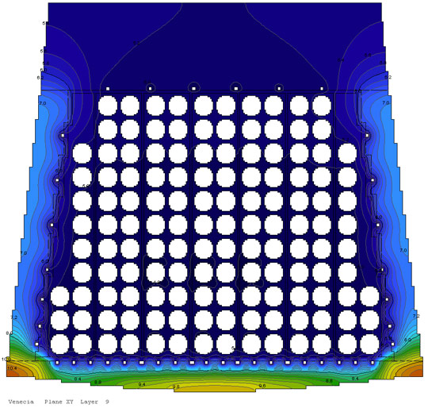
VINCENTA/VENECIA description
VINCENTA recently evolved into VENECIA
Core centered around coolant flow in channels, with or without wall
Additional models for valves, pumps, collectors,… provide the hydraulic network
Heat conduction is solved in 2-D cross sections
The system of PDE is solved by FD in time and space
Monolithic code written in FORTRAN (integrally ?) allows access to all bits and pieces (but complex !)

Slide 31
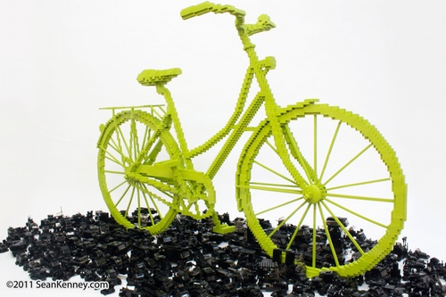
TEXTO [Nic-2010]
Some pedalling work

Slide 32
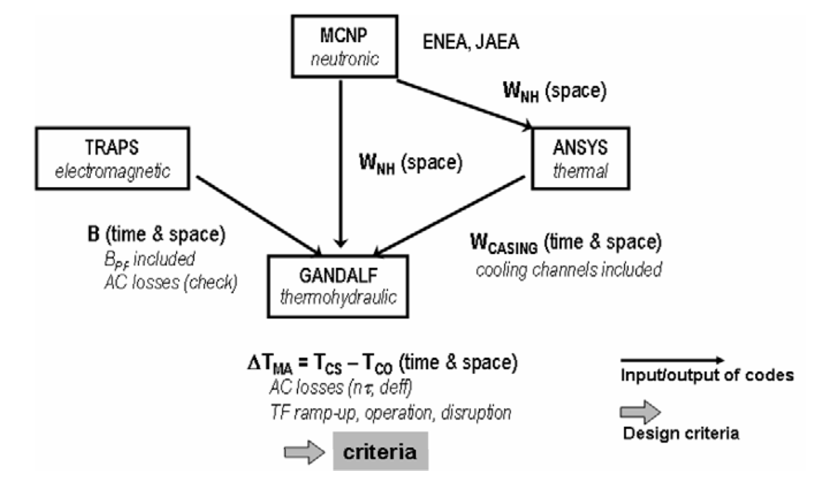
TEXTO description
Couple a number of codes, either on- or off-line, mainly centered on cable simulation
Cable thermo-hydraulics (GANDALF)
Heat conduction (ANSYS) (CAST3M attempted)
Field and AC loss calculation (TRAPS)
Nuclear heating (MNCP4-C)

Slide 33
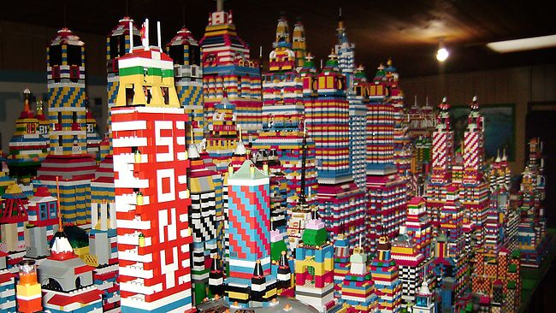
4C [Sav-2010]
Complicacy

Slide 34
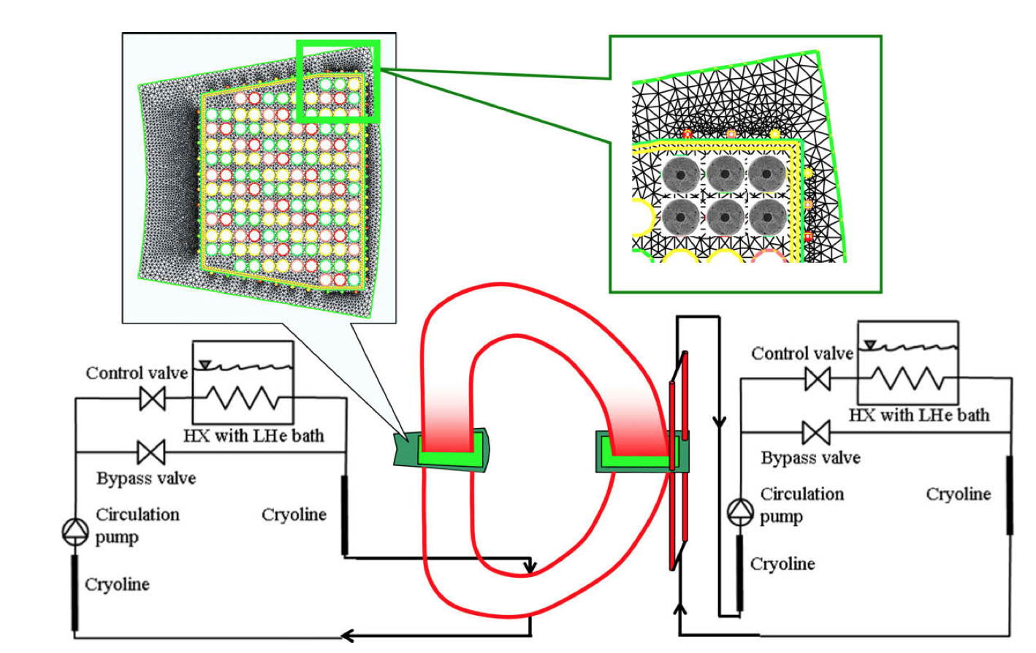
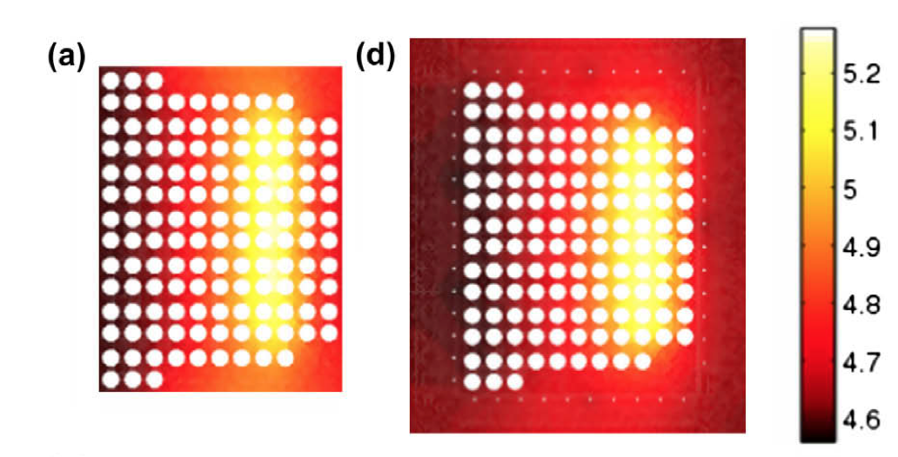
4C description
Several S/W modules run separately to solve a specific domain
Cable and He flow in pipes: M&M
Proximity cryogenics: ThermoPower (Modelica)
Heat transfer in solids: Freefem++
Modules are connected by TISC (TLK Inter Software Connector) to allow communication and sync (under Dymola)
T-distribution during a ITER plasma pulse [Sav-2010]

Slide 35
SuperMagnet [Bot-2007]
Possibilities…

Slide 36
SuperMagnet description
Building blocks, augmented by a unified interface for data exchange
THEA
FLOWER
POWER
HEATER
Process and data manager supervises processes
Data communication based on file system
Synchronization based on UNIX signals
Naturally parallel on a multi-core machine

Slide 37
Other (relevant) models
Quench (Wilson), QLASA (Sorbi), TUT (Stenwall)
Gavrilin [Gav-1992]: 3-D solenoid quench simulation code, including
Eyssa [Eys-1995][Eys-1997]: coupled solenoid quench analysis code
ROXIE [Rus-1993]: interactive code, centered on accelerator magnet design and magnetic optimization, augmented by AC loss and quench models
OPERA-QUENCH [OPE-xxxx]: additional module in the Cobham magnet design and analysis code for integrated 3-D quench analysis

Slide 38
Example: SM analysis of ITER coils
ITER CS, PF, and TF analyed through nominal plasma pulses
Comparison to VINCENTA, mainly from F. Gauthier (ITER-IO)
TF
CS
PF

Slide 39
HEATER model of TF
163706 nodes
151268 elements
38544 edges
32 sections
mesh generated with ANSYS by F. Gauthier (ITER-IO)

Slide 40
HEATER model of TF
Different type of elements can be mixed in the winding cross section to describe the geometry features
mesh generated with ANSYS by F. Gauthier (ITER-IO)

Slide 41
FLOWER model for the TF
TF winding pack cooling
TF structure cooling
132 junctions
25 volumes

Slide 42
TF temperatures
Pancake 1
Pancake 2
Pancake 7
Periodic structure of heat input
outlet
inlet
Difference in residence times

Slide 43
TF electric field
Pancake 1
Pancake 2
Pancake 7
Periodic structure of magnetic field
0.3 W
0.4 W
0.4 W
Non-negligible Joule heat

Slide 44
Comparison to other simulators
CS2 temperature
Direct comparison to VINCENTA provides a satisfactory match when the models have identical inputs (same physics – sometimes not desireable !!!)
PF6 pressure
PF6 temperature
Temperature margins well within allowables

Slide 45
Example: SM 11 T dipole quench
6 blocks coil
2 layers/pole
56 turns
Conductor
40 Nb₃Sn strands
14.7 mm x 1.25 mm
0.1 mm insulation
A_{Nb3Sn} = 7.2 mm²
A_{Cu} = 8.2 mm²
A_{epoxy-glass} = 5.5 mm²
1…9
10…17
18..20
21,22
Inner layer
Outer layer
Heater
1…16
17…34

Slide 46
Simulation
Quench initiation and protection
INZ in the first turn, mid-plane, 10 cm length
Quench detection at 50 mV (5 ms integration time)
OL quench heaters on/off (10 ms delay)
Self-dump (constant inductance, non-linear resistance)
1-D mesh of cable
5000 elements (HARD nodes)
Initial refined region (1 m, 100 elements) around the IHZ
Adaptive refinement, (1 mm minimum element size, 0.1 m maximum mesh size)
1 THEA process (coil), 1 POWER process (circuit)
MacBook Pro, 2.4 GHz, 4 cores, 16 GB
condition | 1D/3D | adaptivity | QH | CPU time
Single conductor | 1D | No | No | 654
Single conductor | 1D | yes | No | 867
Coil | 3D | Yes | No | 1702
Coil | 3D | Yes | OL | 1042
Coil | 3D | Yes | OL+IL | 373

Slide 47
Quench propagation and adaptivity
Adaptive mesh: minimum element size 1 mm
Adaptive mesh tracking fronts
30 m/s
Static mesh: 100 mm
Adaptive mesh tracking is a must for practical quench simulation
600 m/s

Slide 48
Quench heaters and multiple fronts
10 ms
Quench temperature peaks
Mesh density at fronts
20 ms
Heater induced quench
More fronts
Mesh adapts at single heater quench front
40 ms
First block quenches
quench fronts collapse

Slide 49
Summary results
Current decay during quench
Temperature rise at the hot-spot
Optimistic assumptions (5 ms detection, 10 ms quench heater delay) still yield marginal results at this current density (≈650 A/mm²) and energy density (≈100 MJ/m³)

Slide 50
Summary
We have come a long way, and the most complex situations can be modeled in a consistent and very pleasant manner through all relevant scales
It is now time to consolidate
Execution speed
Modeling flexibility and simplicity
Open technical issues
Coupling of thermal fields for fast thermal transients
Geometry/topology pre-processing
Results post-processing
Looking forward to the next CHATS-AS workshop (Boston, October 2013) for a further iteration on computational physics for applied superconductivity !

Slide 51
References
[Lee-1978] A.Y. Lee, Adv. Cryo. Eng., 23, 235, 1978.
[Hof-1979] J.K. Hoffer, IEEE Trans. Mag., 15, 331, 1979.
[Ben-1979] J. Benkowitsch, KfK Report 2813, 1979.
[Mar-1979] C. Marinucci, M.A. Hilal, et al. Proc 8th Symp Eng Prob Fusion Res IEEE 79CH141-5 NPS, 1424, 1979.
[Arp-1980] 1980 Superconducting MHD Magnet Design Conference, MIT, 142-157, 1980.
[Jun-1983] D. Junghans, Cryogenics, 23, 220-216, 1983.
[Mar-1983] C. Marinucci, Cryogenics, 23, 579-586, 1983.
[Cor-1985] M.C.M. Cornelissen, C.J. Hoogendoorn, Cryogenics, 25, 185-193, 1985
[Aga-1987] K. Agatsuma, IEEE Trans. Mag., 23(2), 1543, 1987.
[Sek-1989] S. Sekiya, Cryogenics, 29, 25-30, 1989.
[Tad-1989] E. Tada, Cryogenics, 29, 830-840, 1989.
[Won-1989] R.L. Wong, IEEE Proc. SOFE, 1134-1137, 1989.
[Luo-1989] C.A. Luongo, IEEE Trans Mag 25(2), 1589–1595, 1989.
[Kam-1991] A. Kamitani, Cryogenics, 31, 110-118, 1991.
[Bot-1992] L. Bottura, Cryogenics, 32, 659, 1992.
[Gav-1992] A. Gavrilin, Cryogenics, 32, 390-393, 1992.
[Mey-1993] R. Meyber, J. Fus. Energy, 12 (1-2), 99-105, 1993
[Nie-1993] Niessen, E.M.J., Continuum electromagnetics of composite superconductors, PhD thesis, University of Twente, The Netherlands, 1993.
[Rus-1993] S. Russenschuck, ROXIE - the routine for the optimization of magnet X-sections, inverse field computation and coil end design, CERN-LHC-Note-238, 1993
[Sha-1994] A. Shajii, J. Freidberg, J. Appl. Phys., 76(5), 3149, 1994.
[Mar-1994] A. Martinez, Cryogenics, 34, 591-594, 1994.
[Bot-1994] L. Bottura, IEEE Trans. Mag., 30(4), 1978-1981, 1994.
[Akh-1994] A. Akhmetov, et al., J. Appl. Phys. 75, 3176, 1994.
[Kre-1995] L. Krempasky, C. Schmidt, Jour. Appl. Phys., 78 (9), 5800-5810, 1995.
[Eys-1995] Y.M. Eyssa, D. Markiewicz, IEEE TAS 5(2), 487-490, 1995.
[Zan-1995] R. Zanino, S. DePalo, L. Bottura J Fus Energy, 14, 25-40, 1995.
[Bot-1996] L. Bottura, J. Comp. Phys., 125, 26-41, 1996.
[Koi-1996] N. Koizumi, Cryogenics, 36(9), 649-659, 1996.
[Eys-1997] Y.M. Eyssa, IEEE TAS 7(2), 159-162, 1997
[Bot-1999] L. Bottura, C. Rosso, Int J Numer Meth Fluid,s 30,1091–108, 1999.
[Bot-2000] L. Bottura, C. Rosso, M. Breschi, Cryogenics, 40(8–10), 617–626. 2000.
[Bot-2002] L. Bottura, M. Breschi, M. Fabbri, J. Appl. Phys. 92, 7571, 2002.
[Bot-2003] L. Bottura, C. Rosso, Cryogenics, 43, 215-223, 2003.
[Zan-2005] R. Zanino, et al., Fus. Eng. Des., 75-79, 23-27, 2005
[Ver-2006] A. Verweij, Cryogenics, 46, 619-626, 2006
[Ger-2006] J.M. Gery, Modeling The Quench Process in Super-conducting Coils, presentation at CHATS-2006, unpublished.
[Bot-2007] SuperMagnet. User’s Guide. CryoSoft, Ver. 1.0; 2007.
[Sav-2010] L. Savoldi, Cryogenics, 50, 167–176, 2010.
[Laa-2010] E.P.A. van Lanen, A. Nijhuis, Cryogenics, 50, 139–148, 2010.
[Nic-2010] S. Nicollet, Cryogenics, 50, 18–27, 2010.
[Bra-2013] B. Bradu, Cryogenics, 53, 45–50, 2013.
[Ven-2013] http://www.alphysica.com/index.php/venecia.html

